Slide 1



NeuroSync: Intent-Aware Code-Based Problem Solving via Direct LLM Understanding Modification
Wenshuo ZHANG, Leixian Shen, Shuchang Xu, Jindu Wang
Jian Zhao, Huamin Qu, Lin-Ping Yuan
Wenshuo ZHANG
Ph.D. Student @ Vislab, HKUST. wzhangeb@connect.ust.hk
Notes:
Email: xxx
原则1：一样的信息应该放在一起

Slide 3
Background
Formative Study
Concept
NeuroSync
Result and Takeaway
Notes:
一般要和论文里边的标题保持一致。

Slide 4

Background > Formative Study > Concept > NeuroSync > Result & Takeaway
Scenario and Target User:
domain experts need to solve problems in their fields by programming but lack programming knowledge. Conversational LLMs like ChatGPT help by generating code from prompts, lowering the barrier to programming.
3/31

Slide 5
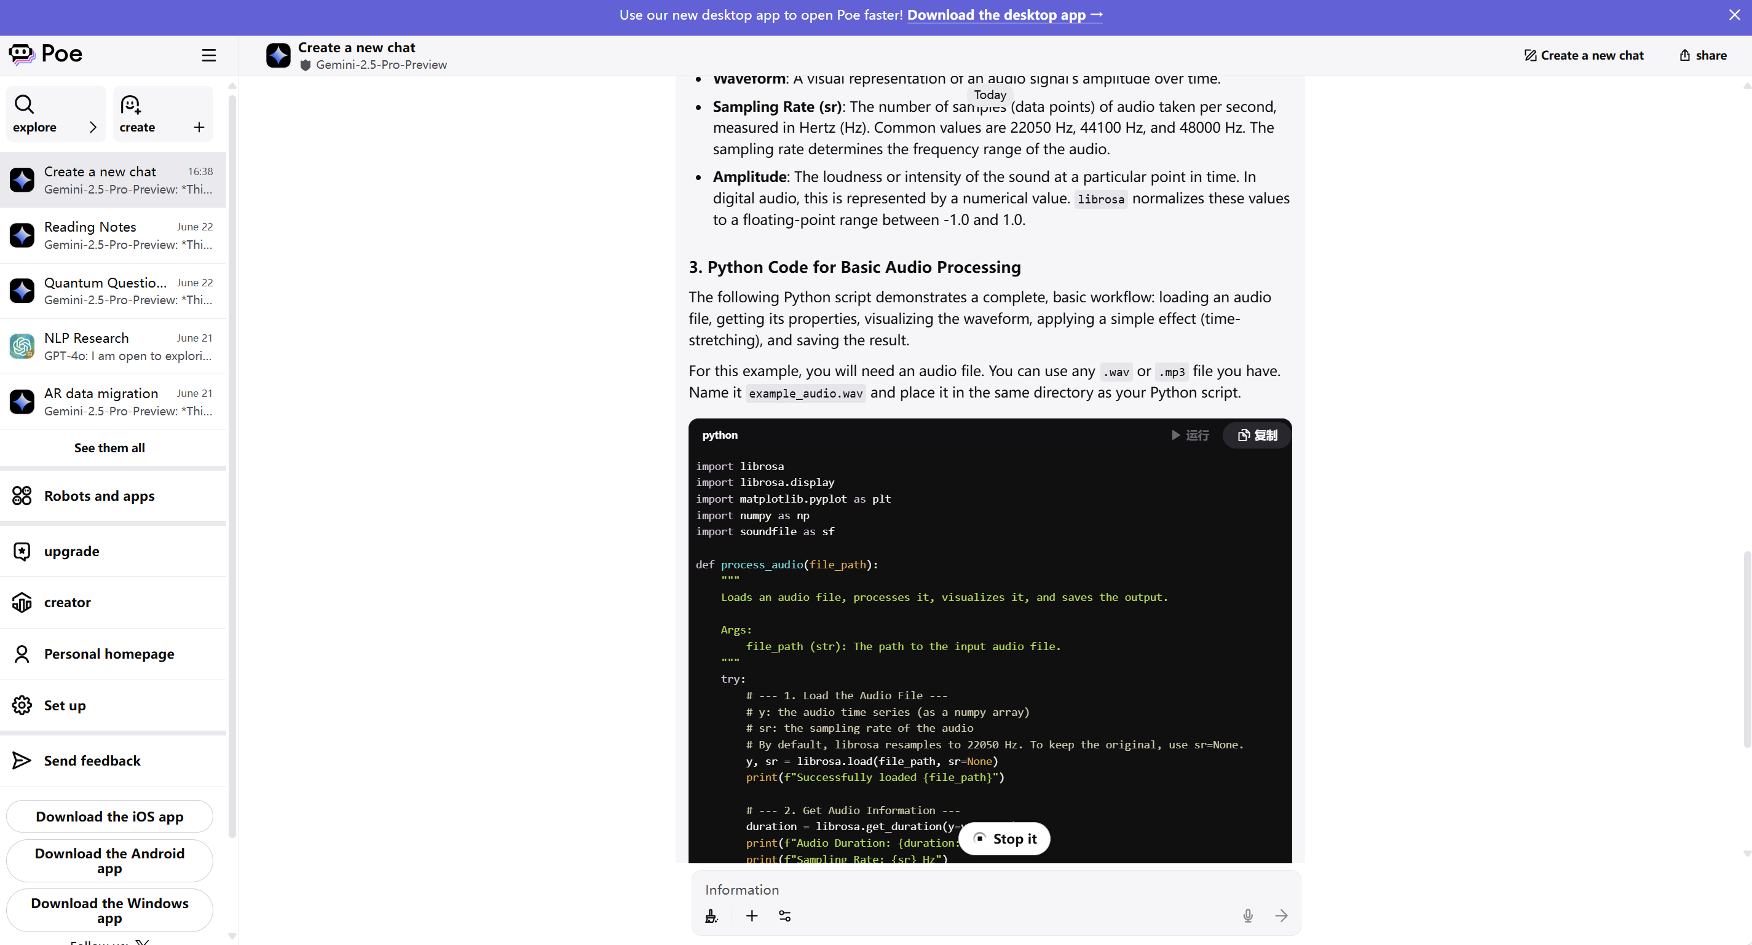


Background > Formative Study > Concept > NeuroSync > Result & Takeaway
Misalignment always happens in this process (Abstract Match).
The tasks done in LLM generated code doesn’t match what domain users intent to do.
Misalignment typically leads to repetitive cycles of clarification and debugging, causing frustration and failure.
Users input Multi Rounds Prompt
User Need
I want to Finish Task A, B, C and D
1. Task B should be done when A and D is done
2. Task C should be done when all are done
…(Other indented requirements)
LLM’s Understanding
Code finish Task A, B, D
Task B be done after A and D
Miss other requirements
Miss task C and other relationship (Misalignment)
LLM generated multi rounds code based on users’ instruction
4/31

Slide 6
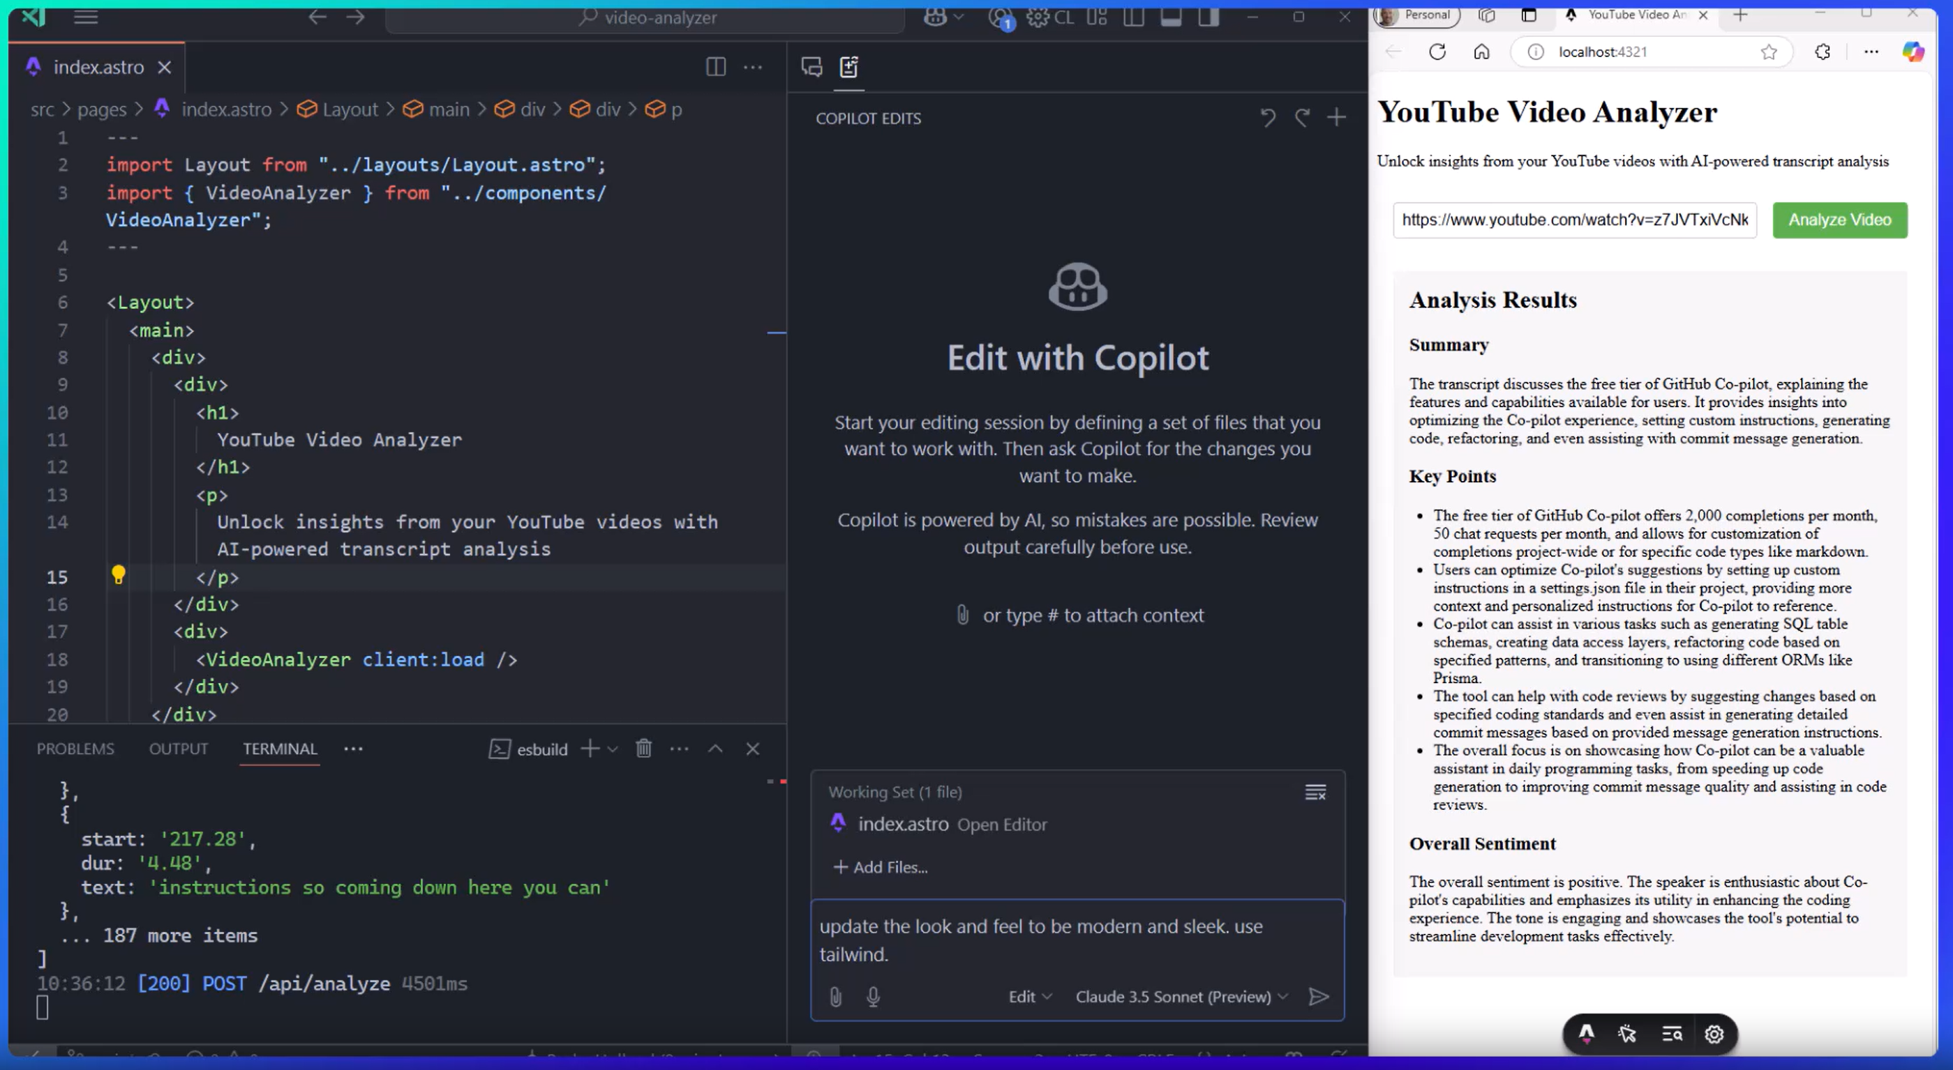
Background > Formative Study > Concept > NeuroSync > Result & Takeaway
Wasted interaction and time by misalignment
Novice user need to cocreate with LLM to generate code.
2. This studio mode cannot fit intent switching
5/31

Slide 7
Background
Formative Study
Concept
NeuroSync
Result and Takeaway
Notes:
一般要和论文里边的标题保持一致。

Slide 8
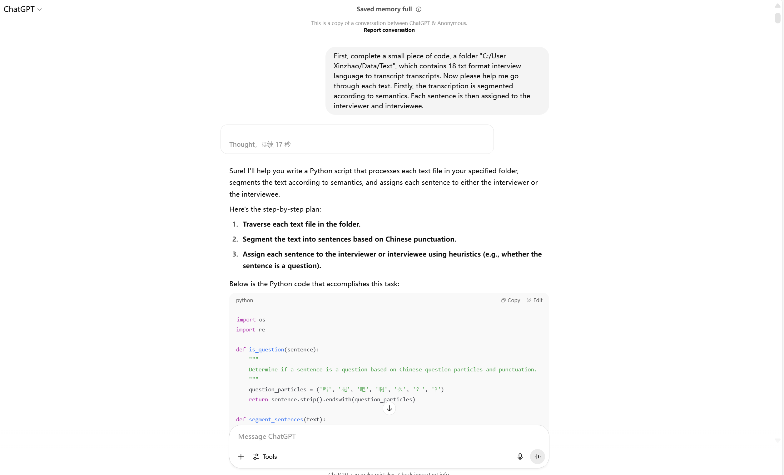
Background > Formative Study > Concept > NeuroSync > Result & Takeaway
We collect real world interaction history and do “open coding analyze”
We invited 6 domain expert and collect their dialog history to do history mining and Q&A to analyze user intent, code task and why they keep interact with LLM
7/31

Slide 9
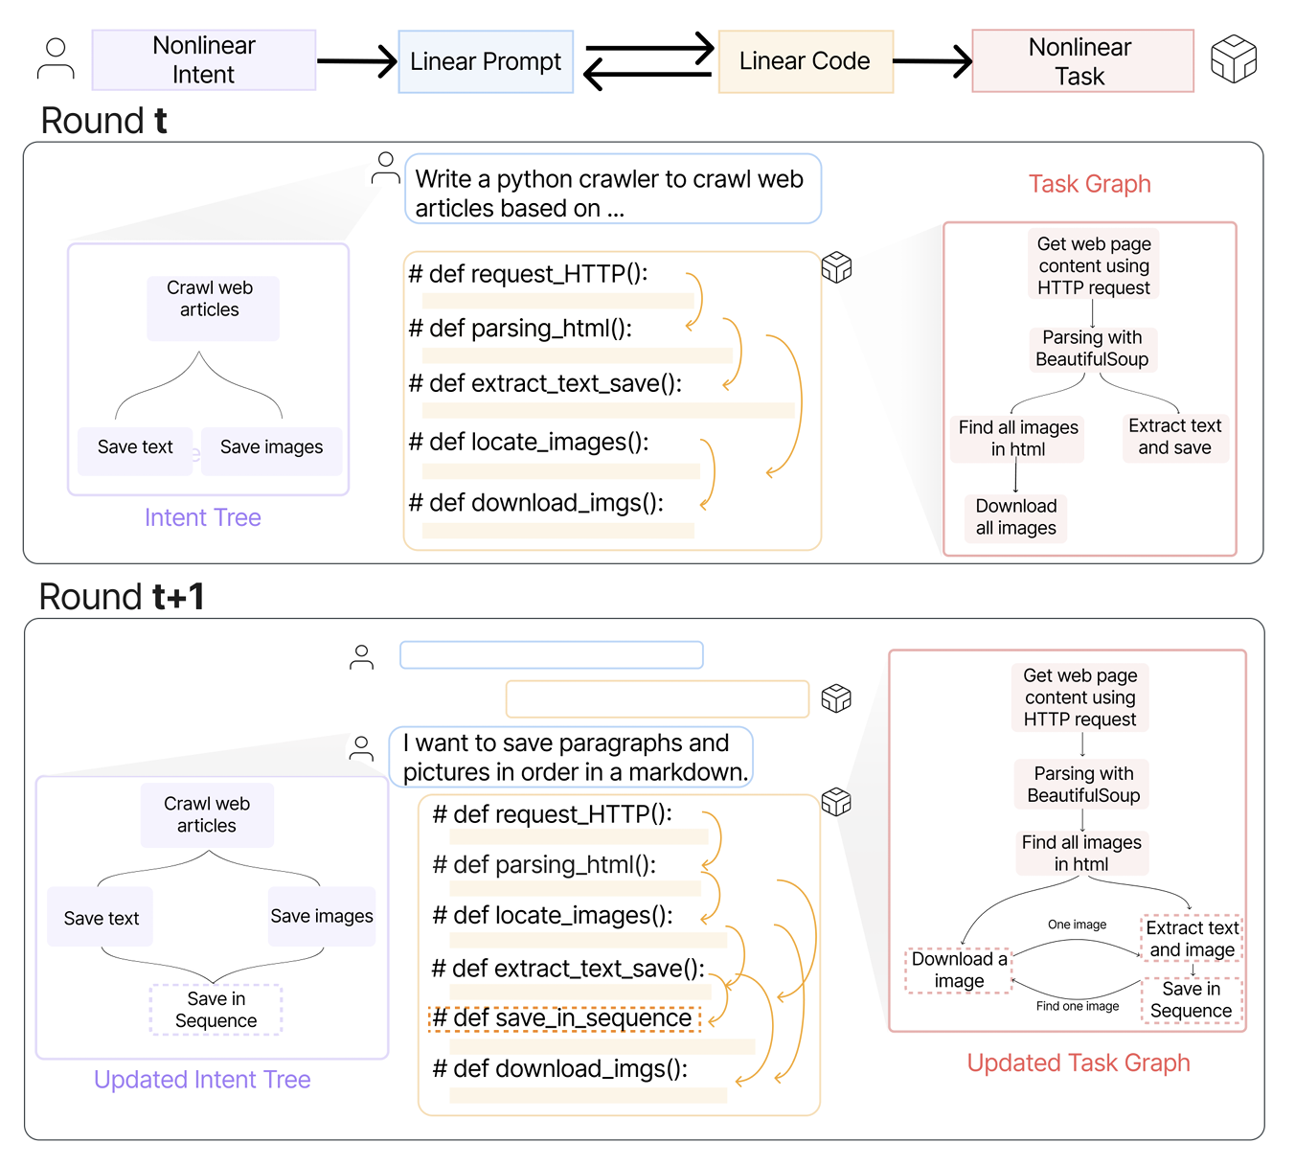
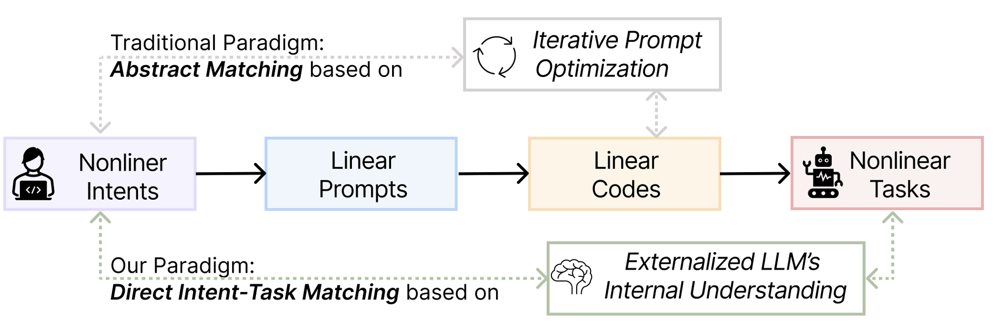
Background > Formative Study > Concept > NeuroSync > Result & Takeaway
Misalignment exist due to Bidirectional Ambiguity
“Bidirectional Ambiguity”
User to LLM Ambiguity
LLM to User Ambiguity
“Abstract Matching”
Prompts and code presented in linear forms do not effectively convey non-linear. So how?
8/31

Slide 10
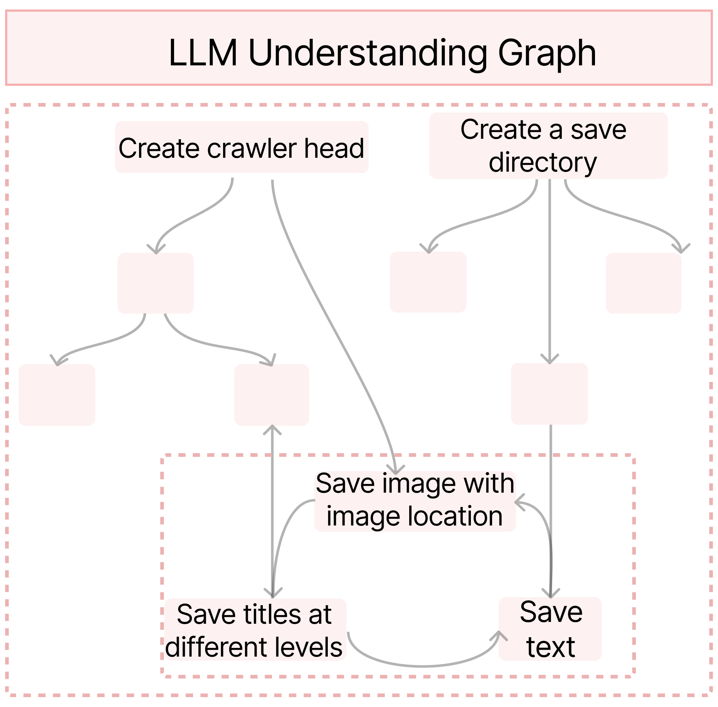
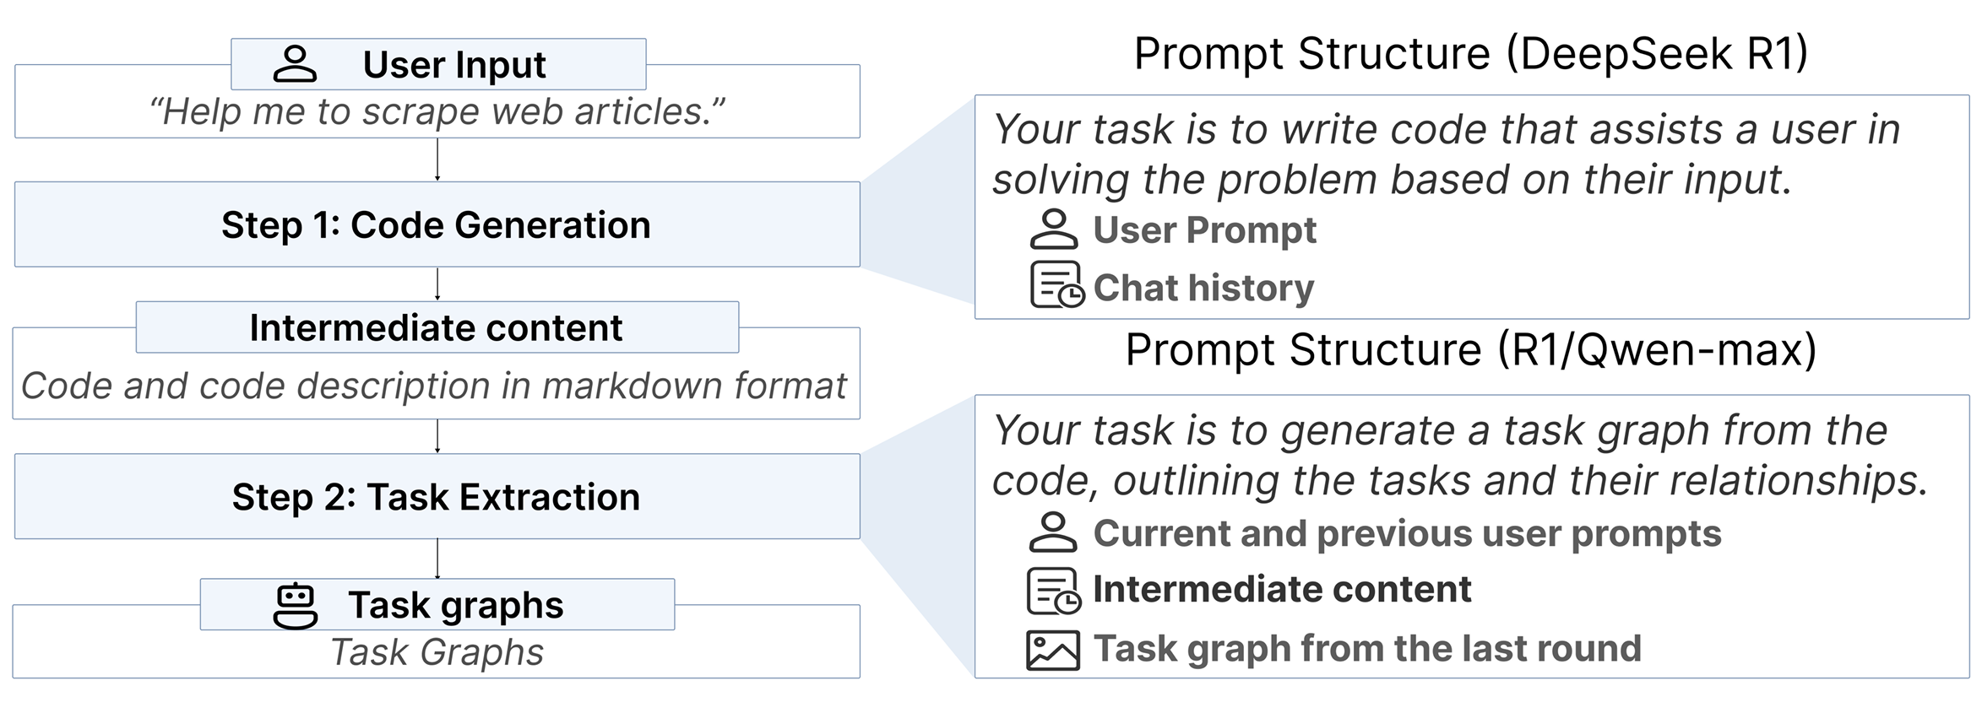
Background > Formative Study > Concept > NeuroSync > Result & Takeaway
Graph is a better format
Question1: What is a good format
Task Flow Diagram is a Better Format
Question2: What are requirements in dialog
We designed a tech probe
Findings:
Graph should be zoomed to highlight important parts that are related to intent
Graph is a good format for users to interact with. However, there should be special design like zooming graph based on users’ intent focus and provide more interaction methods
9/31

Slide 11
Background > Formative Study > Concept > NeuroSync > Result & Takeaway
System Requirement
DC1: Support Bidirectional Disambiguation through Intent and Task Externalization.
DC2: Enhance fluid modification on tasks to align intents in multi-round.
DC3: Leverage Structured Graph Representations with Intent-Aware Abstraction.
10/31

Slide 12
Background
Formative Study
Concept
NeuroSync
Result and Takeaway
Notes:
一般要和论文里边的标题保持一致。

Slide 13

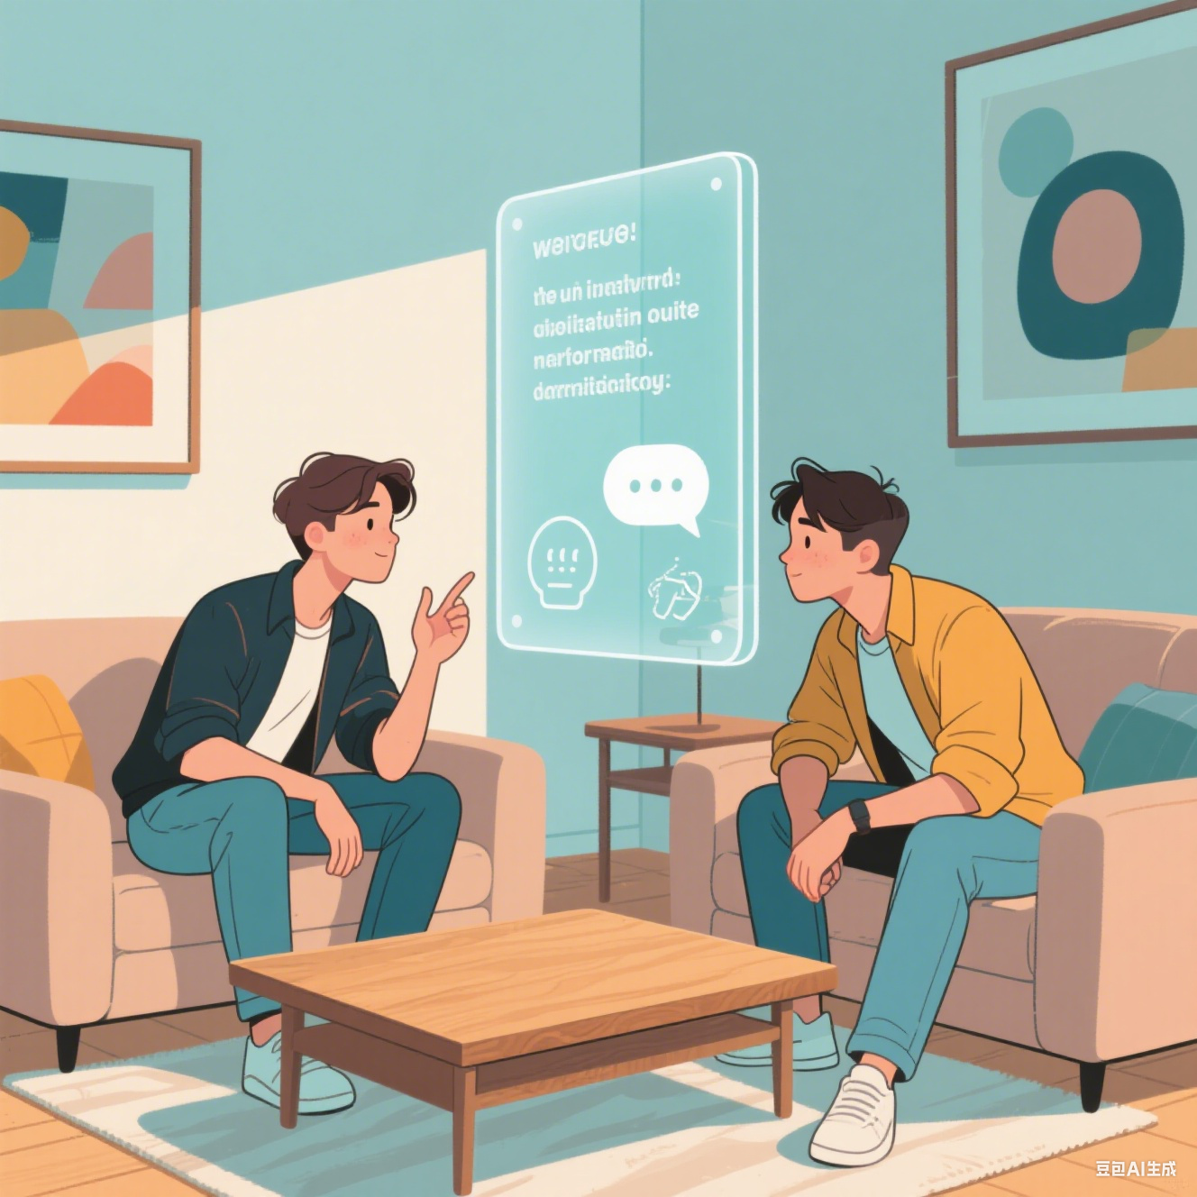
Background > Formative Study > Concept > NeuroSync > Result & Takeaway
12/31

Slide 14
Background > Formative Study > Concept > NeuroSync > Result & Takeaway
LLM Understanding and Direct Intent -Task Matching
Understanding: What LLM think based on user input.
Which should be generated before LLM response and present to user to modify for task level alignment and avoid useless iteration rounds
Direct Intent-Task Matching: User direct modify task based on intent before code generation.
a process that allows users to engage directly with the LLM understanding before code is generated to address bidirectional ambiguity. Instead of relying on traditional prompt iteration or adjusting mismatched outputs after generation, users can iteratively refine how the LLM interprets their intent into specific coding tasks.
13/31

Slide 15
Background
Formative Study
Concept
NeuroSync
Result and Takeaway
Notes:
一般要和论文里边的标题保持一致。

Slide 16
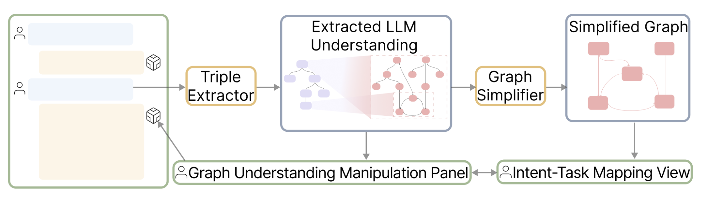
Background > Formative Study > Concept > NeuroSync > Result & Takeaway
Overview of NeuroSync
15/31
Notes:
NeuroSync takes user prompts as input,
extracts the LLM understanding,
enables users to refine this understanding through graph-based visualizations,
and feeds the refined understanding back to the LLM to generate code that more accurately aligns with user intents

Slide 17
Background > Formative Study > Concept > NeuroSync > Result & Takeaway
UI - Graph Based Interaction
User Interface
-> We build the whole UI and modification methods to implementate the framework and support DC1.
16/31
Notes:
User Interface:
To support structured graph representations with intent-aware abstraction, we build the panel B and C
This works as kinds of plugin for original dialog LLM, Users can interact with the interface and detailed control LLM generation

Slide 18
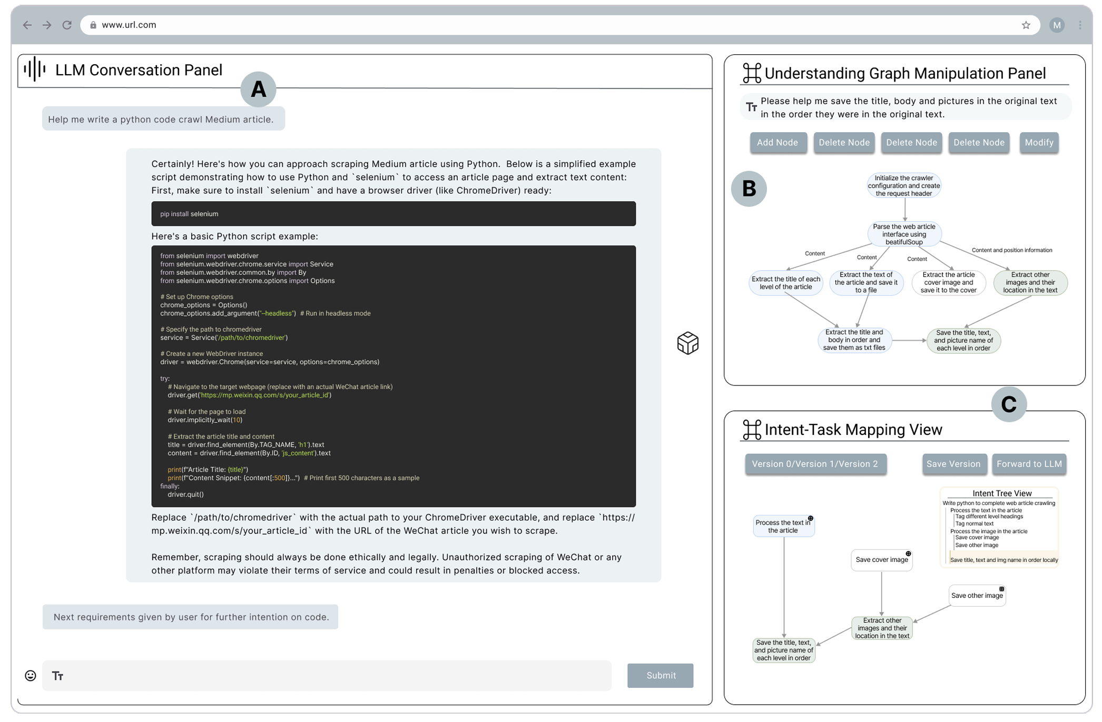
Background > Formative Study > Concept > NeuroSync > Result & Takeaway
UI - Graph Based Interaction
17/31
Notes:
User Interface:
Beside normal panel that users chat with, we provide two more
(1) Panel B: Before each LLM response, the system generates an LLM understanding graph in Panel B (Understanding Graph Manipulation Panel)
(2) Panel C: a simplified version in Panel C (Intent–Task Mapping View).
Users can edit the task graph in Panel B and explore task structures and intent alignment via Panel C.

Slide 19
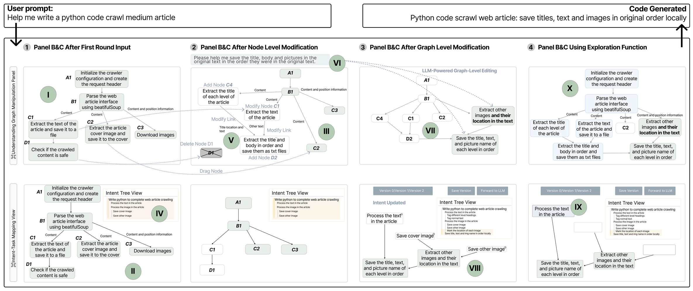
Background > Formative Study > Concept > NeuroSync > Result & Takeaway
UI - Graph Based Interaction
18/31

Slide 20
Background > Formative Study > Concept > NeuroSync > Result & Takeaway
Triple Extractor – A SLM is needed
Triple Extractor
-> To support DC2, a SLM is trained and it is used to faithfully generate triple
19/31

Slide 21
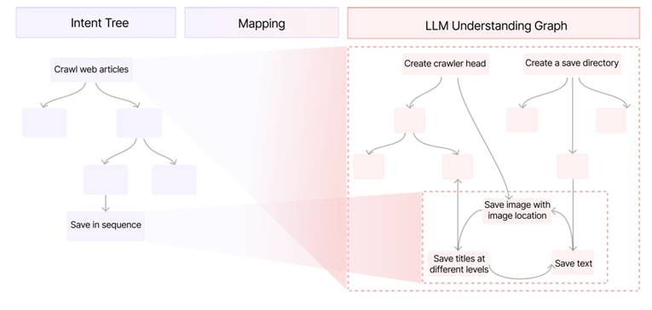
Background > Formative Study > Concept > NeuroSync > Result & Takeaway
Triples
We decide to use “Triple” as explicit representation
User Intent with tree
LLM Understanding with graph
Mapping between them
20/31

Slide 22
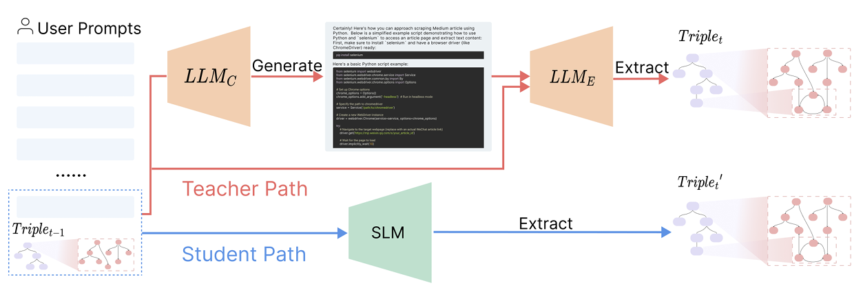
Background > Formative Study > Concept > NeuroSync > Result & Takeaway
Backend - Triple Generation
21/31
Notes:
Triple Distillation Pipeline.
It aligns the SLM in the student path with the two-stage extractor in the teacher path. The SLM can extract triples directly from prompts, by passing intermediate code generation to speed up triple extraction.

Slide 23
Background > Formative Study > Concept > NeuroSync > Result & Takeaway
Triple Extractor – A SLM is needed
Multi-Agent Playground for dataset generation
-> To train SLM and support DC 2 then, multi-agents playground is built to simulate interaction and generate data
22/31

Slide 24
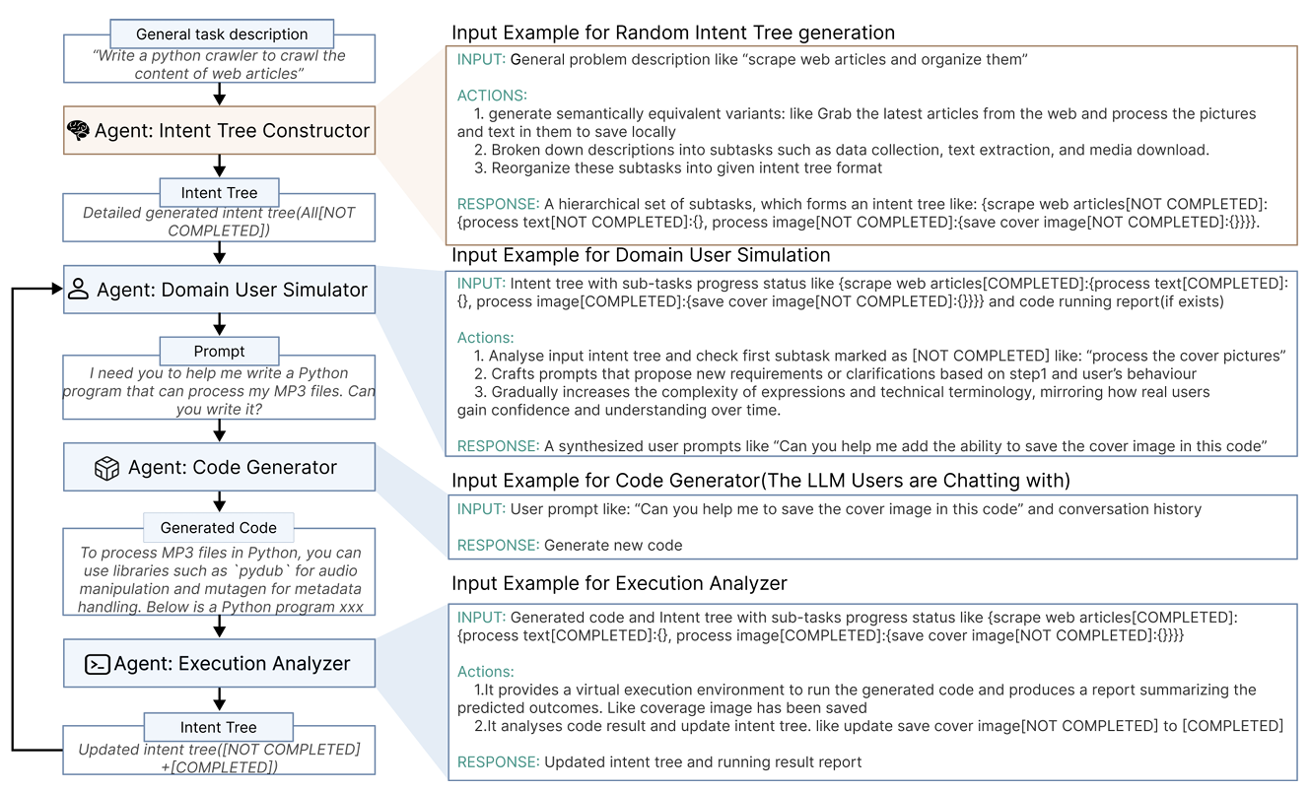
Background > Formative Study > Concept > NeuroSync > Result & Takeaway
Backend – Data Simulation
23/31
Notes:
Multi-Agent Module to simulate Dataset Generation
This module involves four agents designed to interact with each other, simulating a domain user’s experience of leveraging an LLM for code generation based on our findings on user behavior patterns.

Slide 25
Background > Formative Study > Concept > NeuroSync > Result & Takeaway
Graph Simplifier – Intent Aware Graph Zoom
Graph Simplifier
-> to support DC3, a simplification algo based on user intent change is needed
24/31

Slide 26
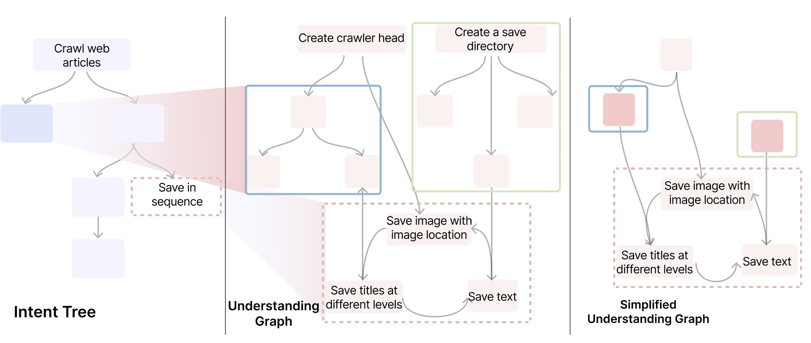
Background > Formative Study > Concept > NeuroSync > Result & Takeaway
Backend – Intent-aware graph simplification
25/31
Notes:
Intent-aware graph simplification algorithm.
The left figure illustrates an intent tree, where each node corresponds to a sub-understanding graph. During the simplification process, nodes that are mapped to changes in the intent tree are directly transferred to the simplified graph (i.e., red dashed box). Meanwhile, parts mapped to unchanged nodes are recursively collapsed or zoomed out (i.e., blue and green boxes)

Slide 27
Background and Formative Study
Concept and User Interface Design
Backend System
Result and Takeaway
Notes:
单击此处添加文本

Slide 28
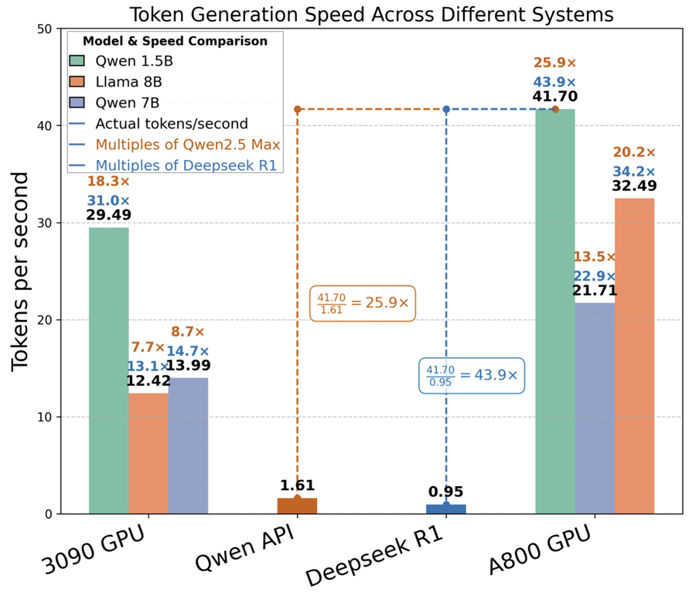
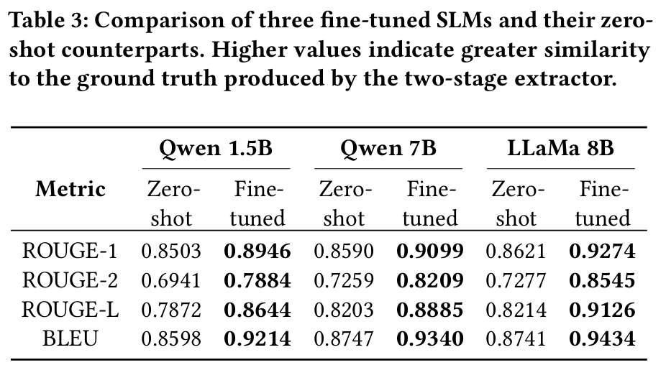
Background > Formative Study > Concept > NeuroSync > Result & Takeaway
Results – Backend Algo
SLM speeds up the process
SLM works well
27/31

Slide 29
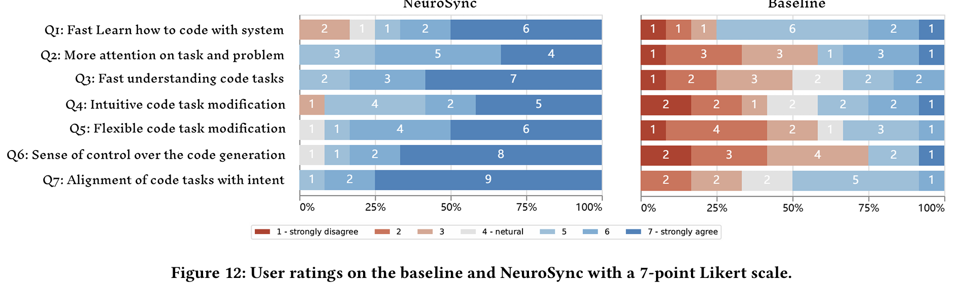
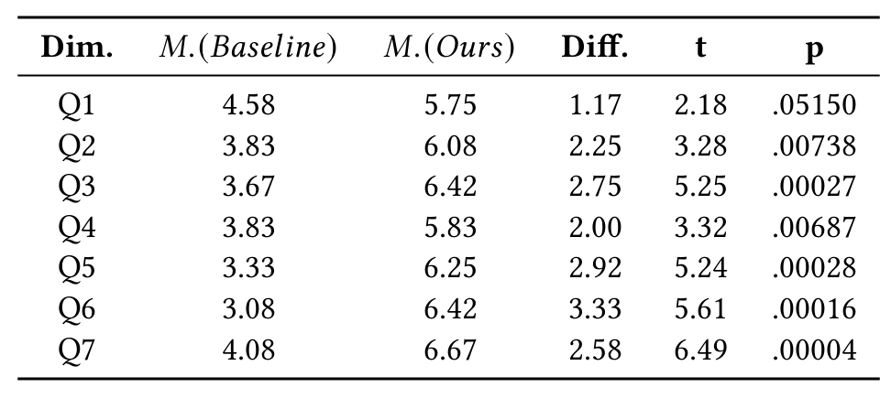
Background > Formative Study > Concept > NeuroSync > Result & Takeaway
Results - SUS
NeuroSync Significantly Improves users experience
In all domains, the results are all good and significant.
28/31

Slide 30
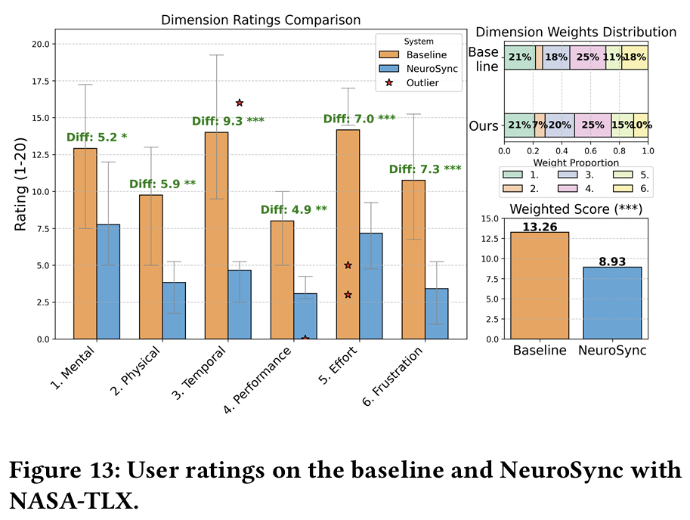
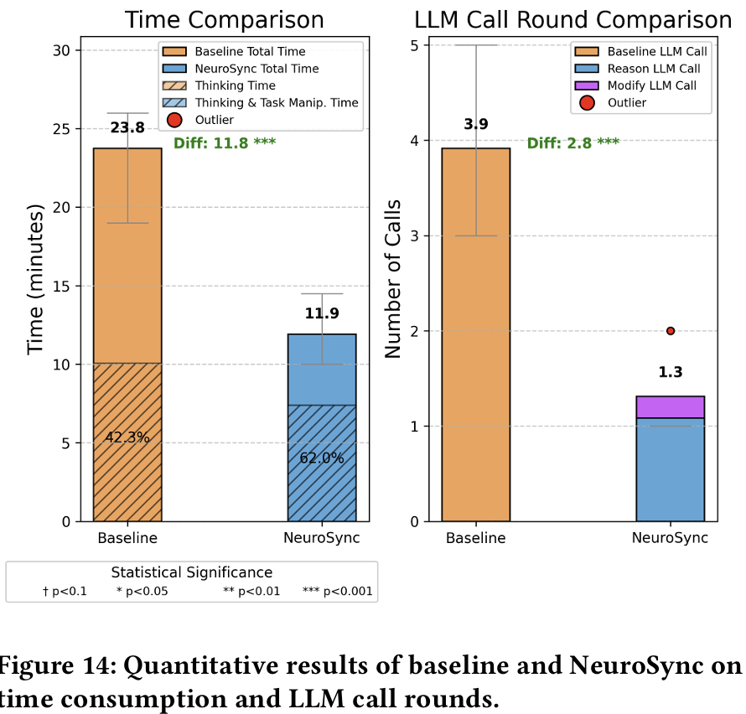
Background > Formative Study > Concept > NeuroSync > Result & Takeaway
Results - Cognitive Load and Total Rounds
NASA TLX
NeuroSync reduces cognitive load and shift users focus.
Interaction Rounds
NeuroSync reduces total rounds and over all time.
29/31

Slide 31
Background > Formative Study > Concept > NeuroSync > Result & Takeaway
Take away
Multi round compression through nonlinear representation and modification
First, since externalization allows users to shift from sequential to parallel misalignment resolution, future systems need to thoughtfully design representations (eg, task graphs) that consolidate sequential steps in domain-specific workflows like programming.
Align with intent changing
Second, direct task-intent matching involves multi-round interactions where user intents are constantly changing. The system should provide targeted information aligned with updated user intents to reduce users’ cognitive load and improve system usability.
30/31

Slide 32


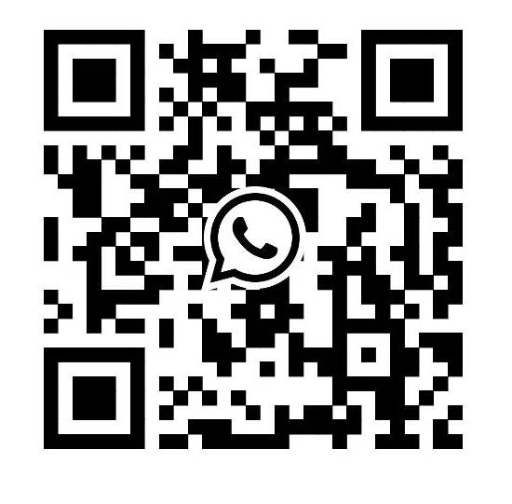
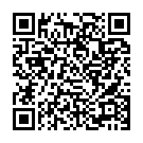
NeuroSync: Intent-Aware Code-Based Problem Solving via Direct LLM Understanding Modification
Wenshuo ZHANG, Leixian Shen, Shuchang Xu, Jindu Wang
Jian Zhao, Huamin Qu, Lin-Ping Yuan
My Wechat
My Whatsup
My CV
Thanks for your attention!
Questions ?
wzhangeb@connect.ust.hk
Notes:
单击此处添加文本

Slide 33
Background > Formative Study > Concept > NeuroSync > Result & Takeaway
Users input Multi Rounds Prompt
LLM generated multi rounds code based on users’ instruction
3/23

Slide 34
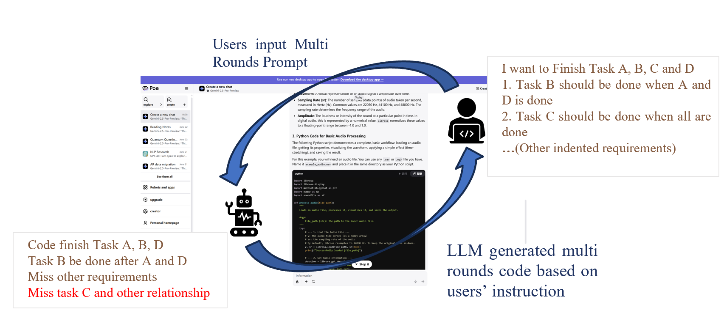
Background > Formative Study > Concept > NeuroSync > Result & Takeaway
Misalignment Happens in Abstract Matching
8/23

